Slide 1
Self-supervised denoising
Szu-Chi Chung

Slide 2
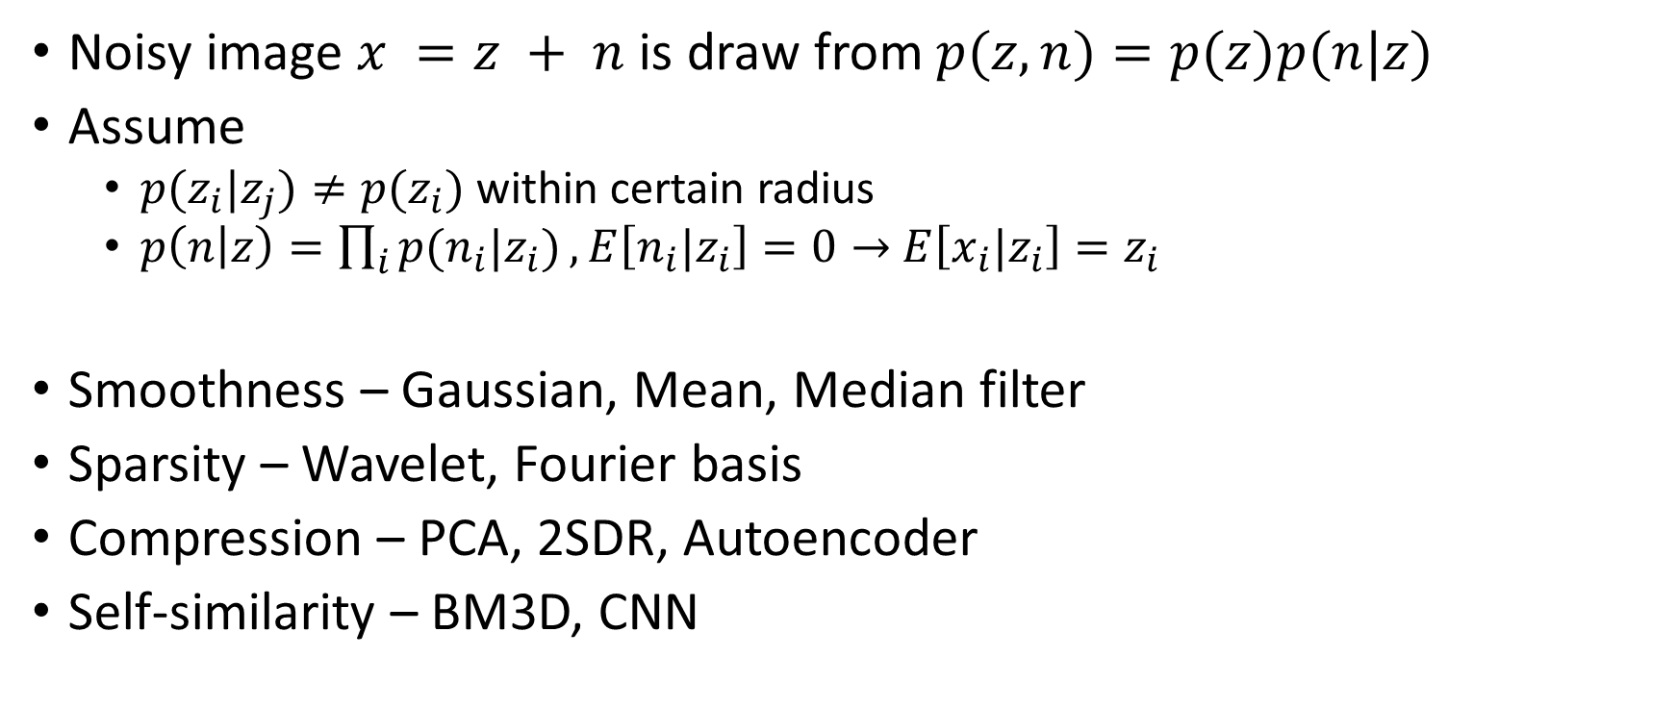
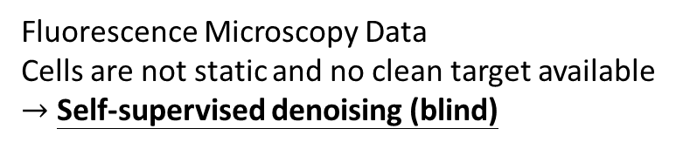
Denoising Strategy [1,2]
Noisy image $x =z + n$ is draw from$p(z,n)=p(z)p(n|z)$
Assume
$p(z_{i}|z_{j})≠p(z_{i})$ within certain radius
$p\left(n | z\right)=\prod_{i}{p(n_{i}|z_{i})}, E\left[n_{i}|z_{i}\right]=0→$ $E\left[x_{i}|z_{i}\right]=z_{i}$
Smoothness – Gaussian, Mean, Median filter
Sparsity – Wavelet, Fourier basis
Compression – PCA, 2SDR, Autoencoder
Self-similarity – BM3D, CNN
Fluorescence Microscopy Data
Cells are not static and no clean target available
$→$ Self-supervised denoising (blind)

Slide 3
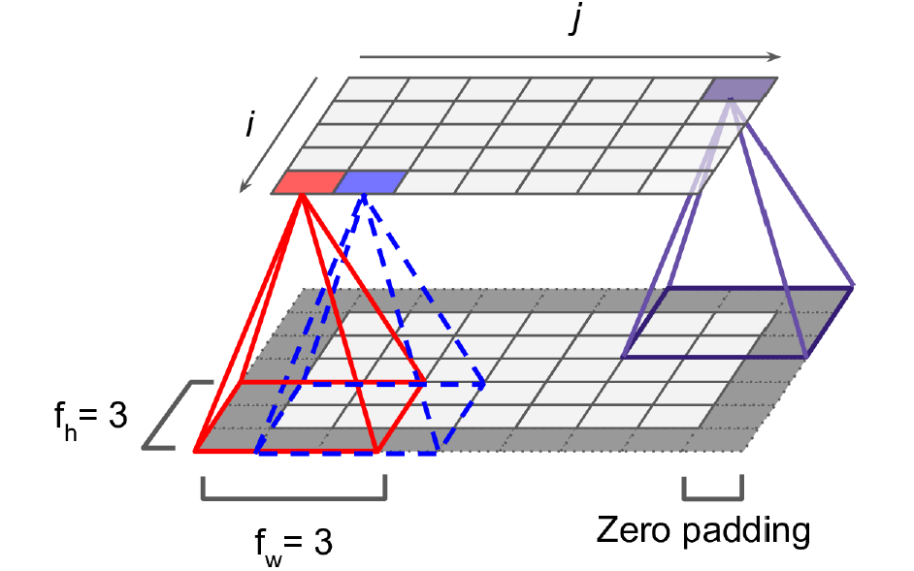
Convolutional Neural Network
The assumption of local receptive field
Weight sharing
Local connected
The receptive filed is increasing
with the number of convolution layer
Notes:
Every pixel is a neuron
https://cs231n.github.io/convolutional-networks/
https://github.com/vdumoulin/conv_arithmetic

Slide 4
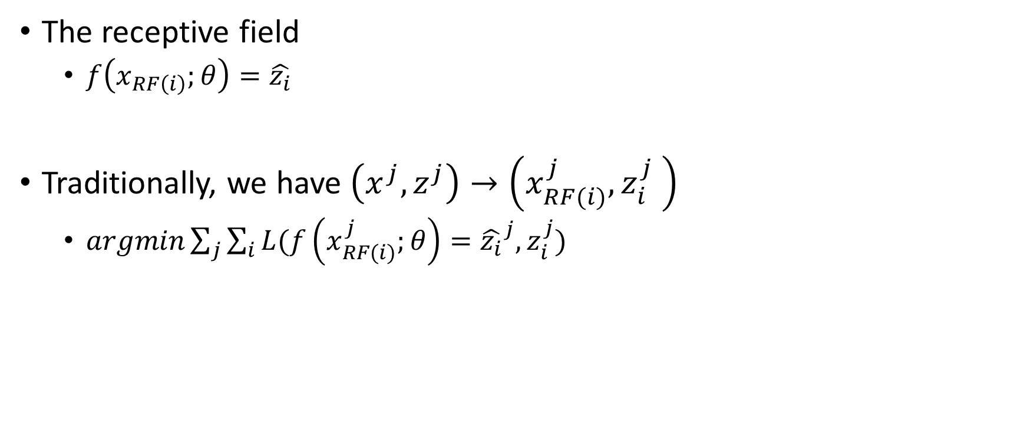
Traditional
The receptive field
$f\left(x_{RF\left(i\right)};θ\right)=\hat{z_{i}}$
Traditionally, we have $\left(x^{j},z^{j}\right)→\left(x_{RF(i)}^{j},z_{i}^{j} \right)$
$argmin\sum_{j}{\sum_{i}{L(f\left(x_{RF(i)}^{j};θ\right)={\hat{z_{i}}}^{j},z_{i}^{j})}}$
Notes:
Neuron vs feature maps
Patches!!

Slide 5
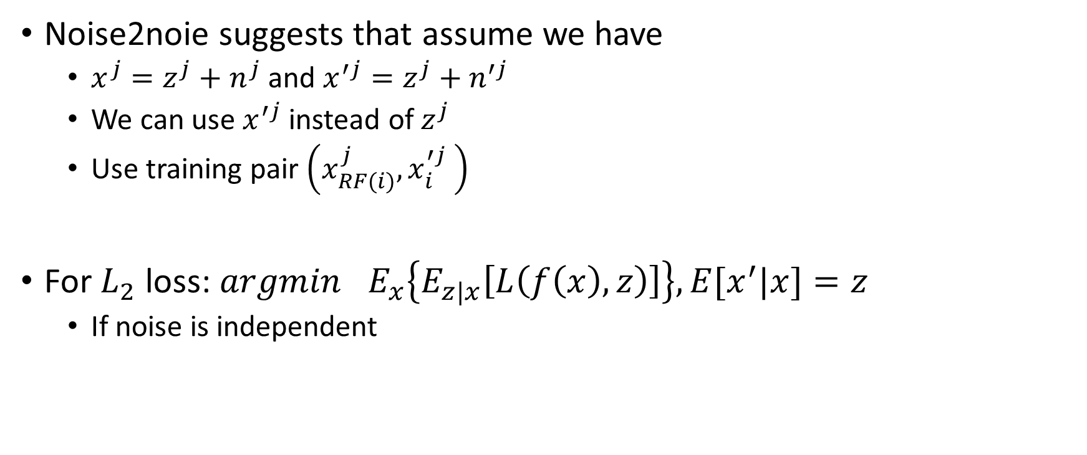
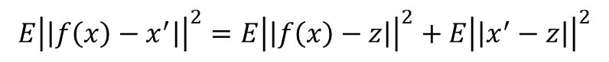
Noise2Noise [3]
Noise2noie suggests that assume we have
$x^{j}=z^{j}+n^{j}$ and $x^{′j}=z^{j}+n^{′j}$
We can use $x^{′j}$ instead of $z^{j}$
Use training pair $\left(x_{RF(i)}^{j},x_{i}^{′j} \right)$
For $L_{2}$ loss:${ argmin}_{}E_{x}\left\{E_{z|x}\left[L\left(f\left(x\right),z\right)\right]\right\}, E[x^{′}|x]=z$
If noise is independent
$$E{\left|\left|f\left(x\right)−x^{′}\right|\right|}^{2}=E{\left|\left|f\left(x\right)−z\right|\right|}^{2}+E{\left|\left|x^{′}−z\right|\right|}^{2}$$
Noisy loss
Ground truth loss
Noisy variance
Notes:
Summation, You can remove any zero-mean noise
X given

Slide 6
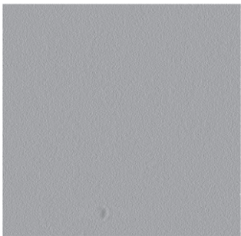
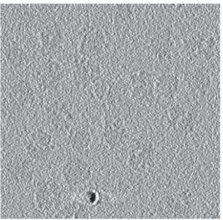
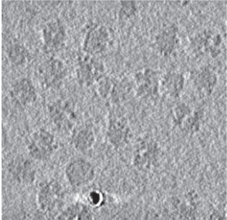
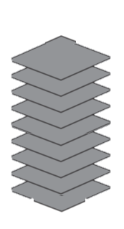

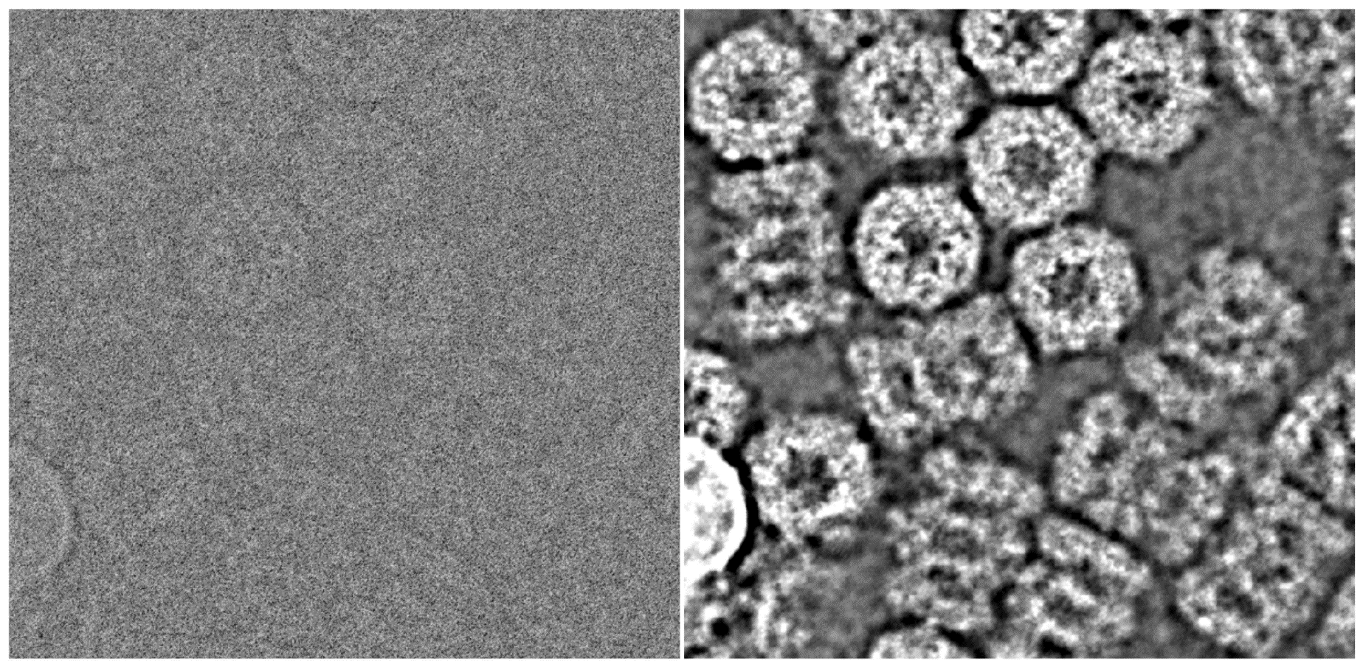
Noise2Noise [11,12]
Tomogram (3D) –Tilt series
(enven-odd reconstruct)
Movies
3D Structure – Half maps
(Warp)
Notes:
Warp, Topaz, Janni, Restore

Slide 7
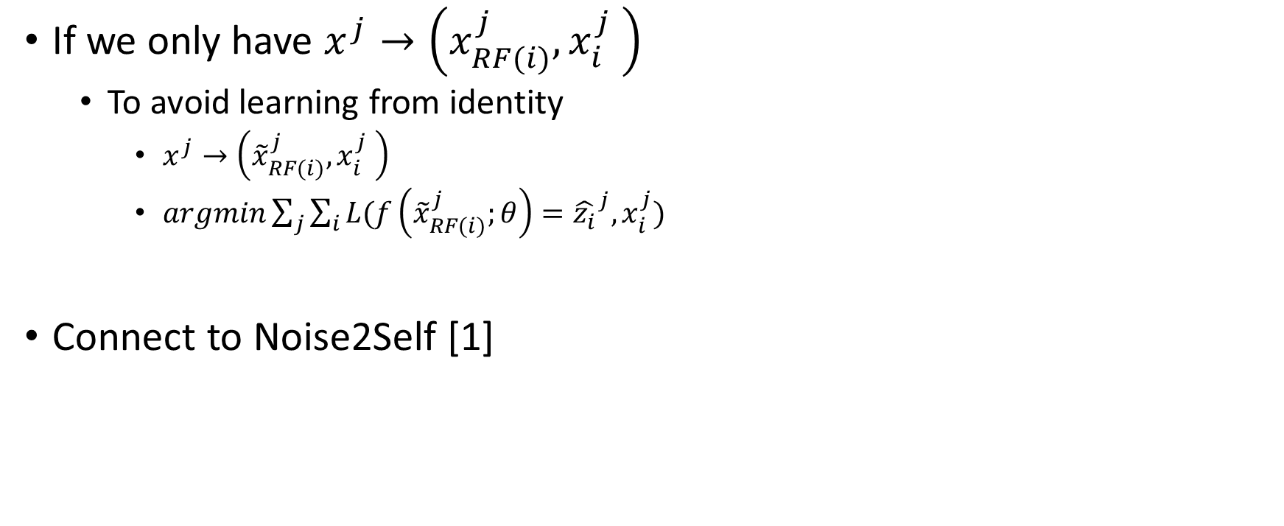
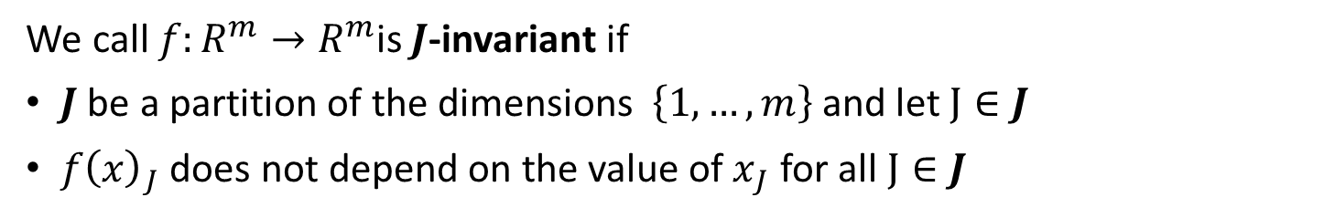
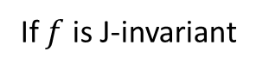
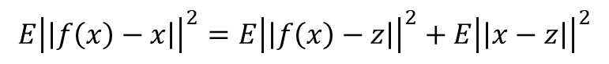
Noise2Void [2]
Target
If we only have $x^{j}→\left(x_{RF(i)}^{j},x_{i}^{j} \right)$
To avoid learning from identity
$x^{j}→\left({\tilde{x}}_{RF(i)}^{j},x_{i}^{j} \right)$
$argmin\sum_{j}{\sum_{i}{L(f\left({\tilde{x}}_{RF(i)}^{j};θ\right)={\hat{z_{i}}}^{j},x_{i}^{j})}}$
Connect to Noise2Self [1]
$$E{\left|\left|f\left(x\right)−x\right|\right|}^{2}=E{\left|\left|f\left(x\right)−z\right|\right|}^{2}+E{\left|\left|x−z\right|\right|}^{2}$$
pixel i (blind spot)
If $f$ is J-invariant
Self-supervised loss
Ground truth loss
Noisy variance
We call $f:R^{m}→R^{m}$is $J$-invariant if
$J$ be a partition of the dimensions $\left\{1,…,m\right\}$ and let $J∈J$
$f{\left(x\right)}_{J}$ does not depend on the value of $x_{J}$ for all $J∈J$

Slide 8
Masking scheme
Uniform Pixel Selection
Replace i with a randomly selected pixel in a square window around it
Gaussian
Add random Gaussian noise on pixel i
Gaussian Fitting
Calculate 1D Gaussian distribution of a square neighborhood fo pixel i and draw a value from the distribution to replace it

Slide 9
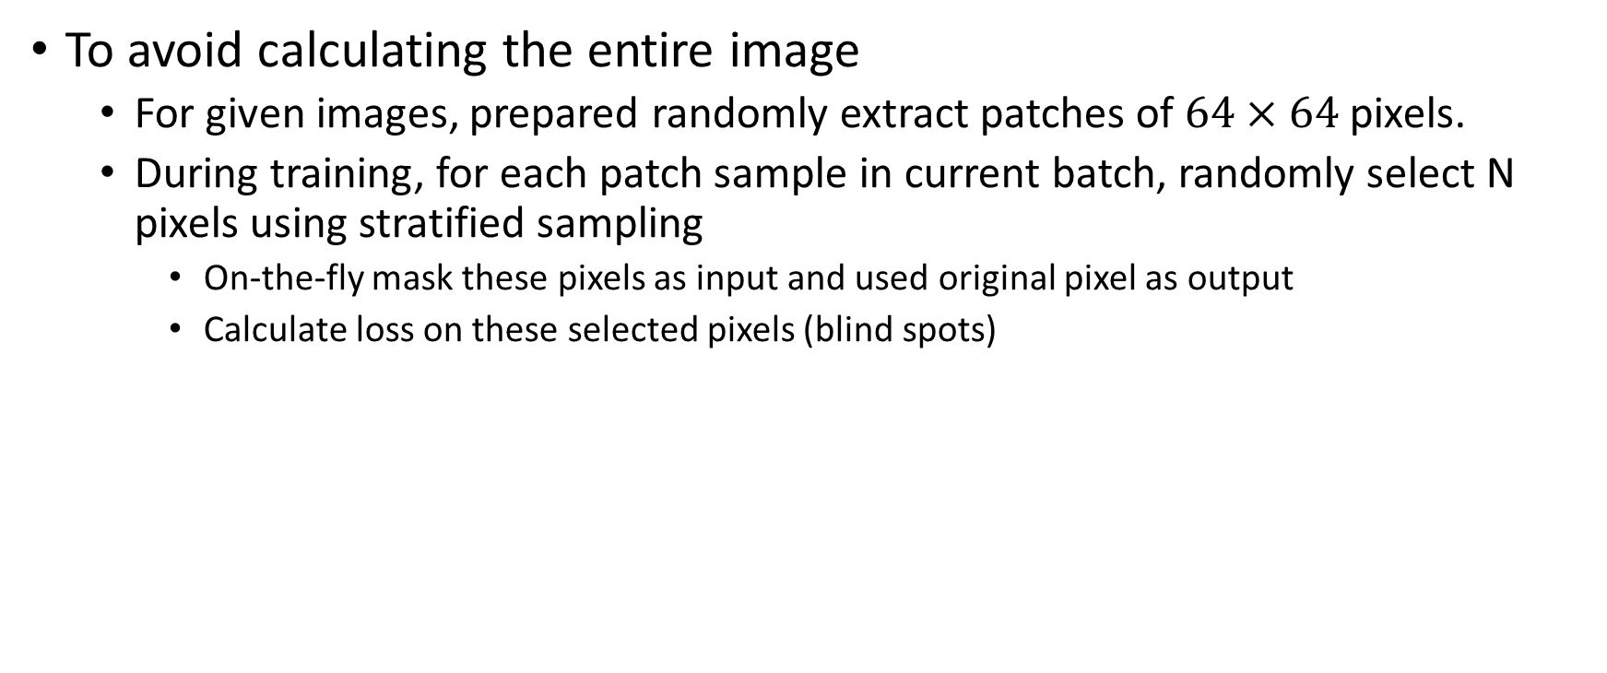
Implementation
To avoid calculating the entire image
For given images, prepared randomly extract patches of $64×64$ pixels.
During training, for each patch sample in current batch, randomly select N pixels using stratified sampling
On-the-fly mask these pixels as input and used original pixel as output
Calculate loss on these selected pixels (blind spots)
Notes:
0.198% pixels
Entire image is still sent into network
Step_per_Epoch = Samples/Batch_size

Slide 10
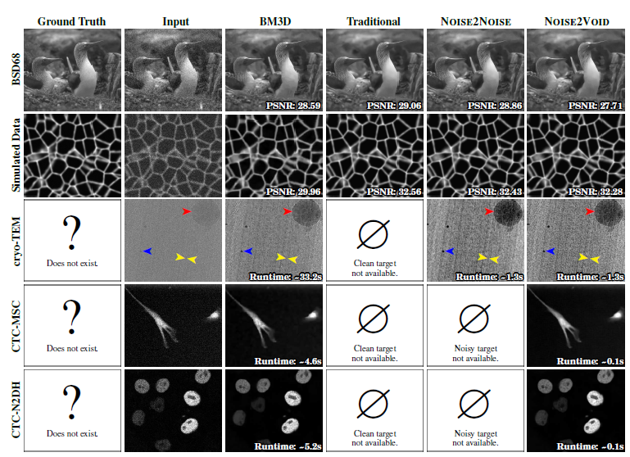
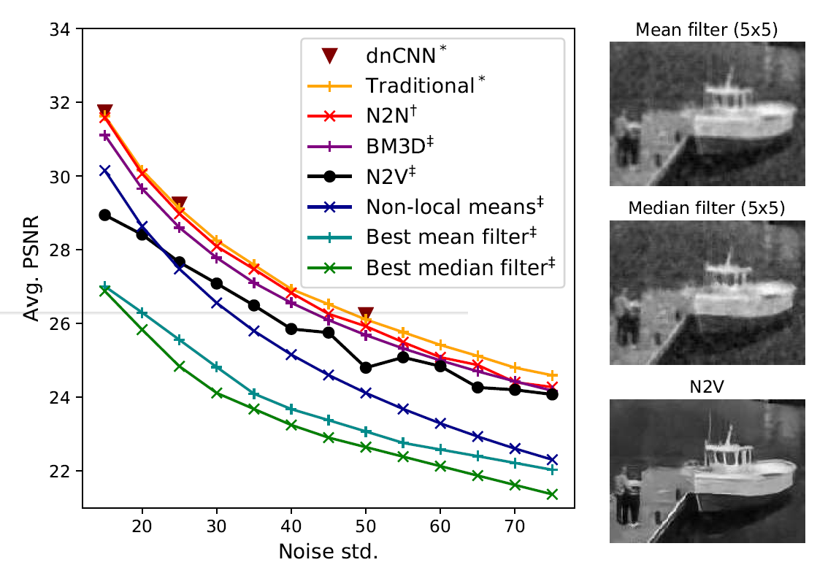
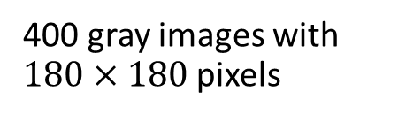
400 gray images with $180×180$ pixels
Mimic shot (Poisson) and readout noise (Gaussian), exposure of fluorescence microscopy

Slide 11
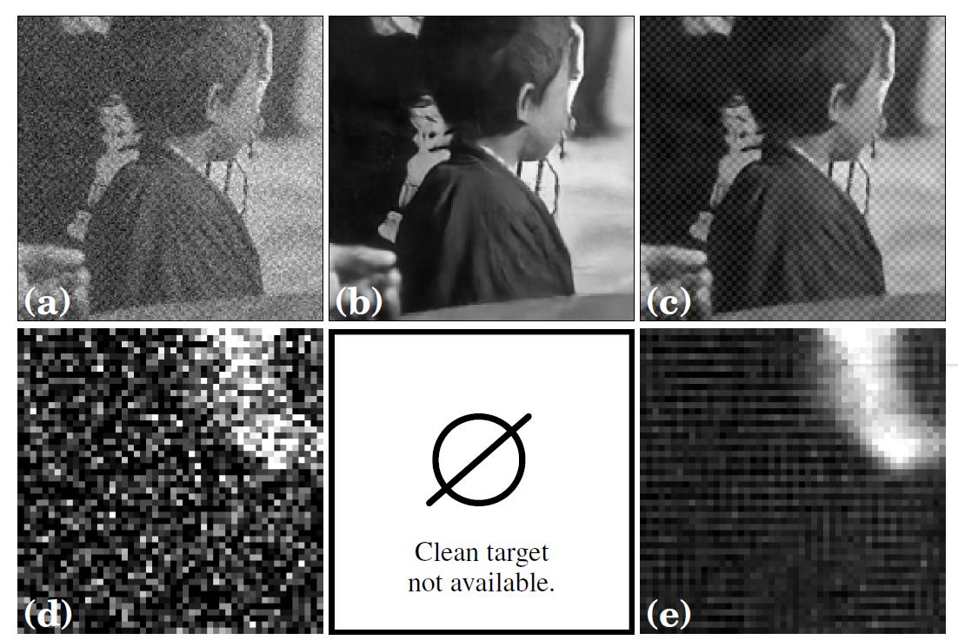
Ground Truth
Traditional
N2V
We do not have the information of the center pixel
Structured noise
Notes:
Artificial, Microscopy
No effect if the noise is not pixel-independent
Can’t correct the pixel-level detail

Slide 12
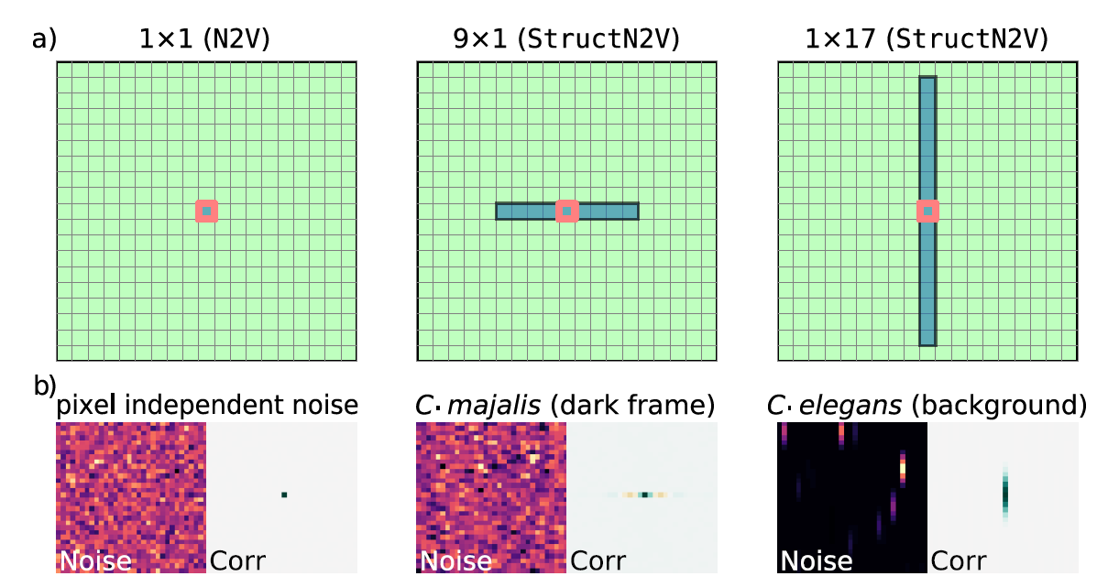
Structured noise [4]
If the length scale of correlations of the noise is smaller than that of the signal
Split masking into active pixel and mask pixels (blind mask)
Use FFT of autocorrelation to determine the mask (on background or dark frame)
Notes:
Green -> receptive field
https://stackoverflow.com/questions/59265603/how-to-find-period-of-signal-autocorrelation-vs-fast-fourier-transform-vs-power

Slide 13
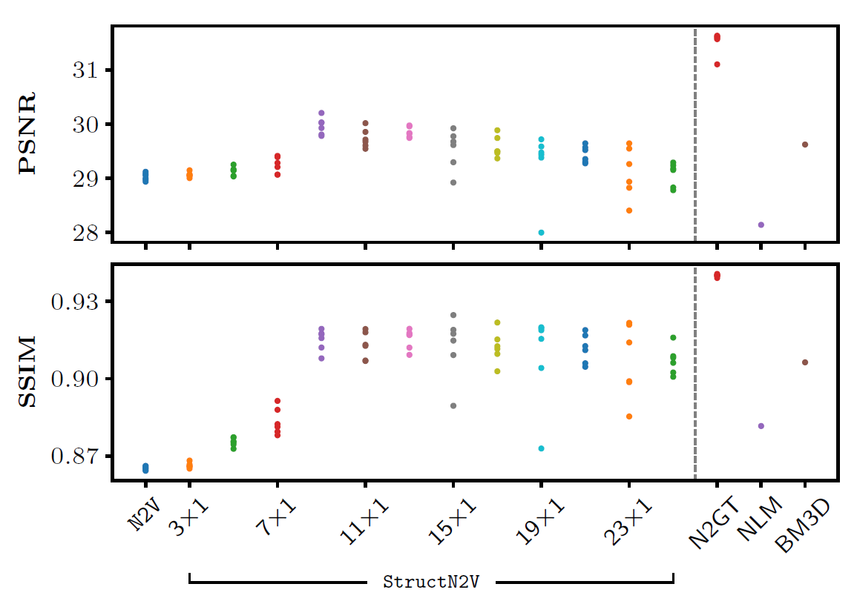
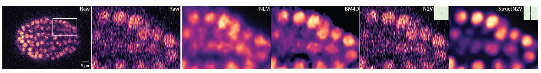
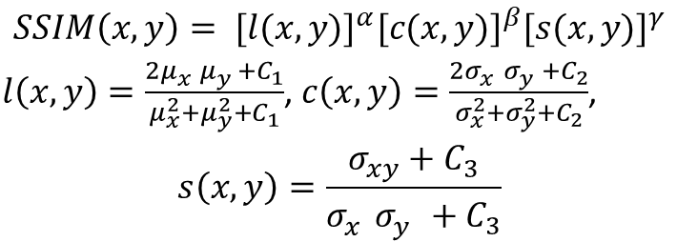
$$SSIM\left(x,y\right)= {[l(x,y)]}^{α}{[c(x,y)]}^{β}{[s(x,y)]}^{γ}$$
$l\left(x,y\right)=\frac{{2μ}_{x}^{}μ_{y}^{}+C_{1}}{μ_{x}^{2}+μ_{y}^{2}+C_{1}}$, $c\left(x,y\right)=\frac{{2σ}_{x}^{}σ_{y}^{}+C_{2}}{σ_{x}^{2}+σ_{y}^{2}+C_{2}}$,
$$s\left(x,y\right)=\frac{σ_{xy}^{}+C_{3}}{σ_{x}^{}σ_{y}^{}+C_{3}}$$
Notes:
Alpha=beta=gamma=1 C3=C2/2
PSNR接近 50dB ，代表壓縮後的圖像僅有些許非常小的誤差。
PSNR大於 30dB ，人眼很難查覺壓縮後和原始影像的差異。
PSNR介於 20dB 到 30dB 之間，人眼就可以察覺出圖像的差異。
PSNR介於 10dB 到 20dB 之間，人眼還是可以用肉眼看出這個圖像原始的結構，且直觀上會判斷兩張圖像不存在很大的差異。
PSNR低於 10dB，人類很難用肉眼去判斷兩個圖像是否為相同，一個圖像是否為另一個圖像的壓縮結果。
亮度、對比度 結構度
SSIM=1就是和原始視訊檔案完全一致，若SSIM>=0.98就是難以與原始視訊檔案分辨區別，而SSIM=0.95的時候大多數人都會對畫面滿意，這個數值可以認為是及格的畫面。SSIM=0.90的時候意味著瑕疵可能要比0.95多一倍，肉眼就會察覺到明顯的畫面劣化，因此低於這個數值時，就可以判定為沒有實際觀賞價值。

Slide 14
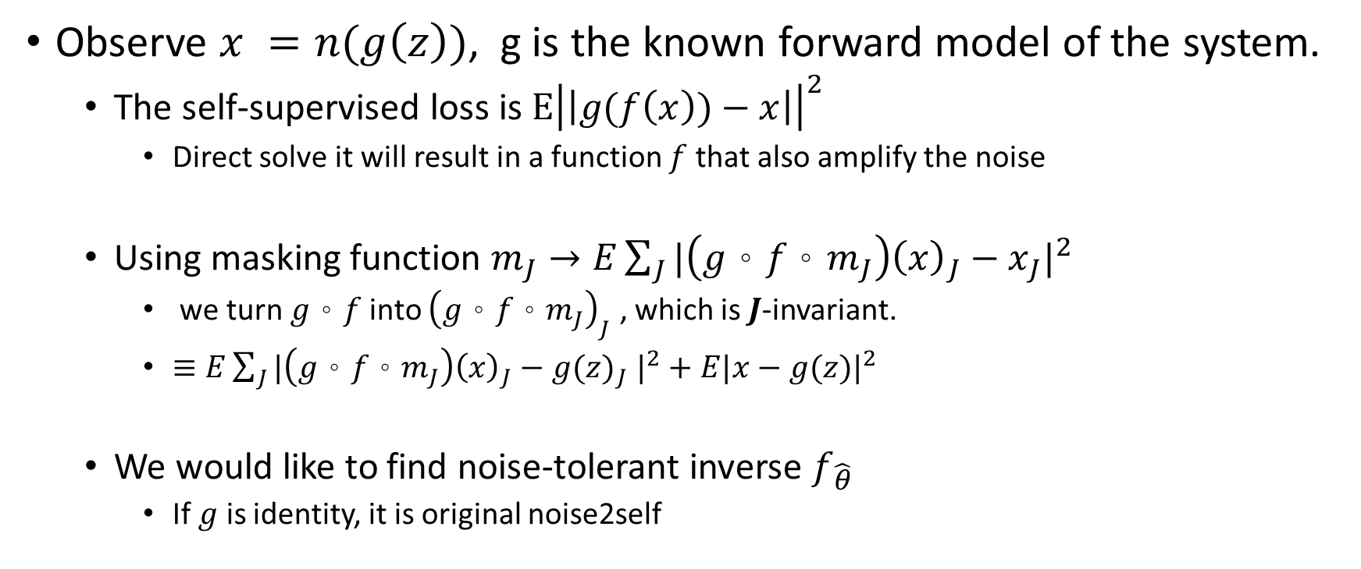
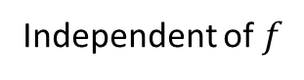
Noise Tolerant Self-Supervised Inversion [5]
Observe $x =n(g\left(z\right))$, g is the known forward model of the system.
The self-supervised loss is $E{\left|\left|g(f\left(x\right))−x\right|\right|}^{2}$
Direct solve it will result in a function $f$ that also amplify the noise
Using masking function $m_{J}→E\sum_{J}{{|\left(g。f。m_{J}\right){\left(x\right)}_{J}−x_{J}|}^{2}}$
we turn $g。f$ into ${\left(g。f。m_{J}\right)}_{J}$ , which is $J$-invariant.
$≡E\sum_{J}{{|\left(g。f。m_{J}\right){\left(x\right)}_{J}−{g(z)}_{J} |}^{2}}+E{|x−g(z)|}^{2}$
We would like to find noise-tolerant inverse $f_{\hat{θ}}$
If $g$ is identity, it is original noise2self
Ground truth loss
Independent of $f$
Notes:
deconvolution

Slide 15
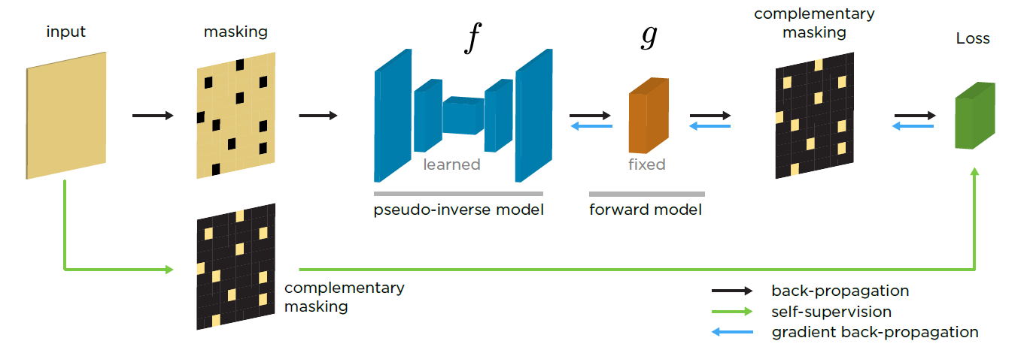
Noise Tolerant Self-Supervised Inversion [5]
Notes:
Assume forward model is also differentiable

Slide 16
Noise Tolerant Self-Supervised Inversion [5]
Simulation data
Apply optical point spread function
Deconvolution performance
Notes:
$n\left(z\right)=s_{p}(z+ƞ\left(z\right)N)$, $ƞ\left(z\right)=\sqrt{αz+σ^{2}}$, $N$ is Gaussian noise, $s_{p}$ is salt-and-pepper noise by replacing proportion $p$ of poxels with random value in $[0,1]$
- The main difference is Wiener is the optimal for Gaussian Noise while Richardson Lucy assumes Poisson Noise.
Poisson Noise is a better model for noise in photos captured by a Photo Diode.
Computationally, in the case of Gaussian Noise and Linear Convolution the solution has a closed form solution in the Maximum Likelihood / LS sense.
The Lucy Richardson method, which is a Maximum Likelihood in the Poisson case, has no closed form solution and requires iterative approach.
https://dsp.stackexchange.com/questions/6144/deconvolution-richardson-lucy-vs-wiener-filter

Slide 17
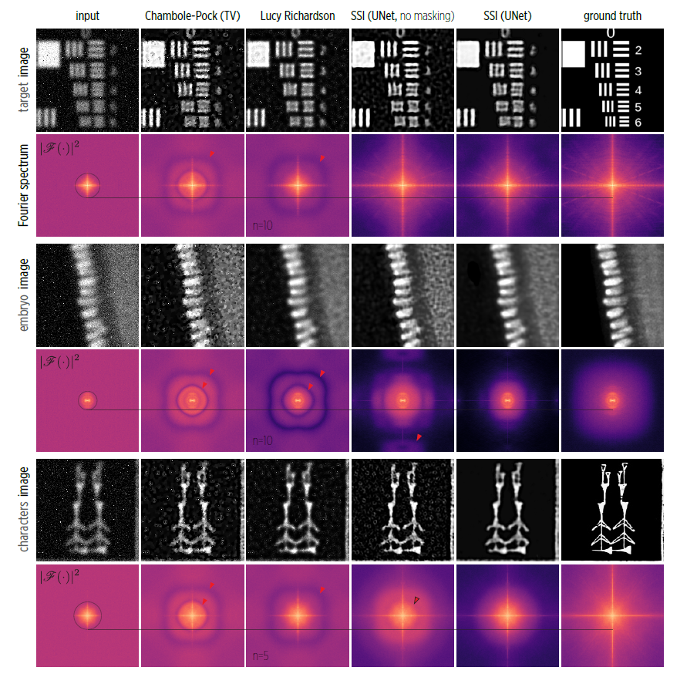

Slide 18
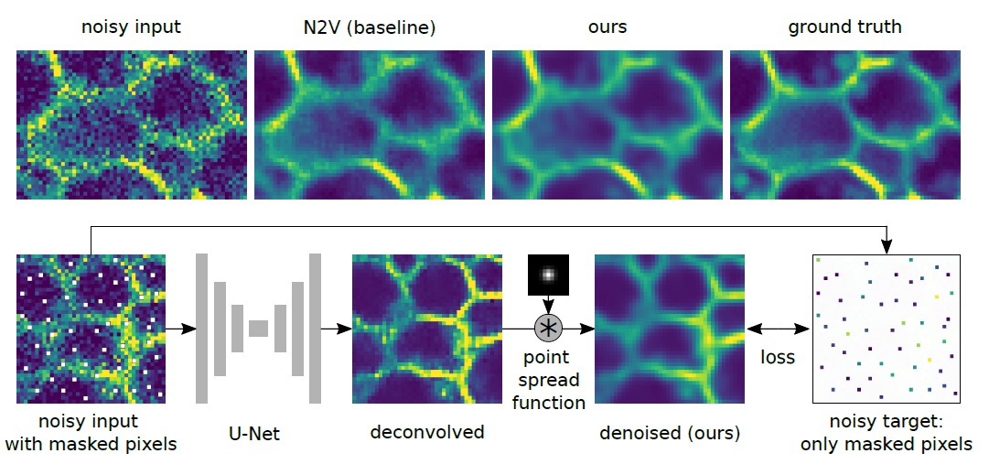
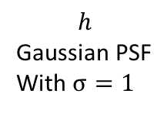
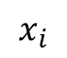
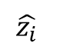
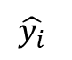
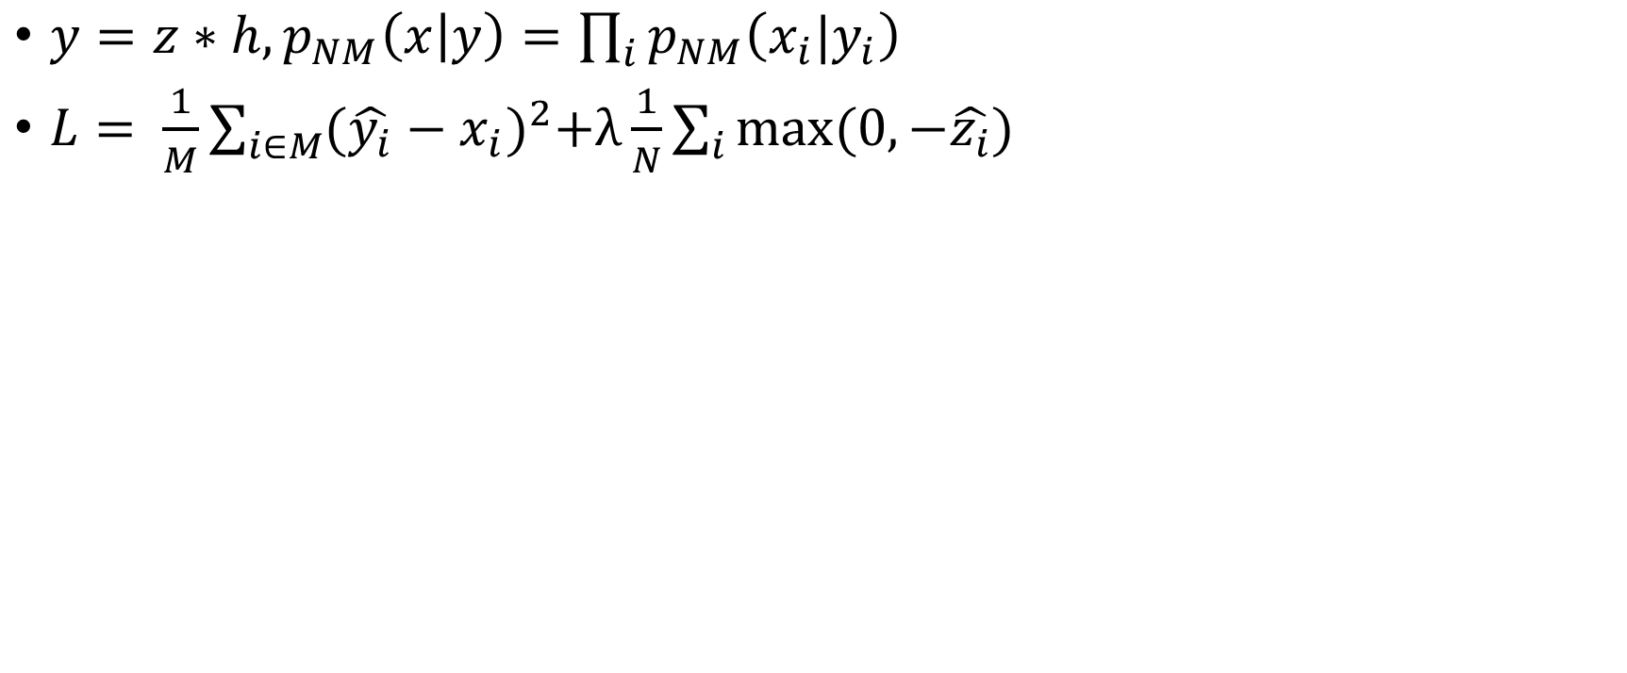
Improving Blind Spot Denoising for Microscopy[6]
$y=z∗h, p_{NM}\left(x | y\right)=\prod_{i}{p_{NM}\left(x_{i}|y_{i}\right)}$
$L= \frac{1}{M}\sum_{i∈M}{{(\hat{y_{i}}−x_{i})}^{2}+λ}\frac{1}{N}\sum_{i}{max⁡(0,−\hat{z_{i}})}$
$$h$$
Gaussian PSF
With $σ=1$
$$x_{i}$$
$$\hat{z_{i}}$$
$$\hat{y_{i}}$$
Notes:
Std need to be set
we know that z cannot take negative values. After all, a negative uorophore concentration can never occur in a physical sample!!
Considering the above-described process of image formation, we know that, since y is the result of a convolution with a PSF, high-frequencies must be
drastically reduced or completely removed. It is thus extremely unlikely that the true signal would include high-frequency features as they.
While a network might in principle learn this from data, blind spot methods usually fail at this and produce high-frequency artifacts.
To avoid this problem, we propose to add a convolution with the PSF after the U-Net . When we now interpret the output after the
convolution as an estimate of the signal, we can be sure that this output is consistent with our model of image formation and can e.g. not contain unrealistic high-frequency artifacts.

Slide 19
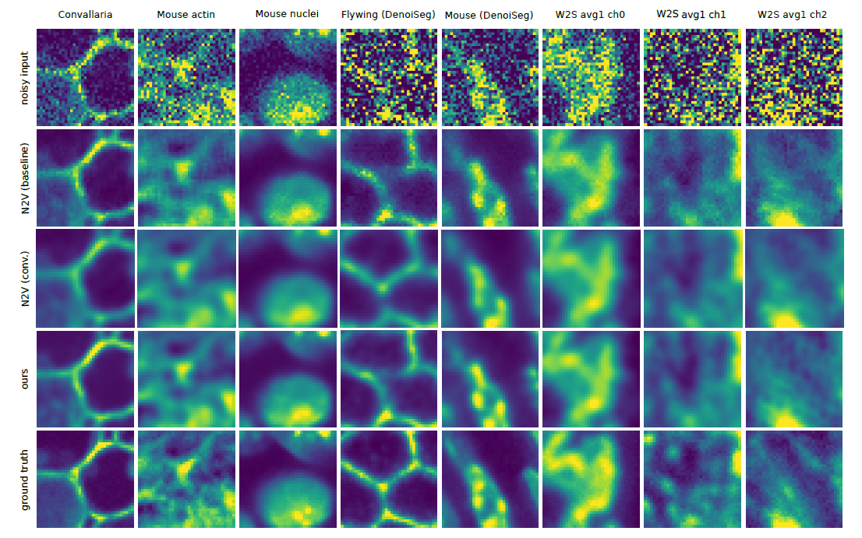
By averaging if not available
Synthetic
Notes:
the ground truth is derived by averaging all images.
We have an interesting observation that such dffierent predicted phantom
images can lead to virtually indistinguishable denoising results after convolution with the PSF, demonstrating how ill-posed the unsupervised deconvolution
problem really is.

Slide 20
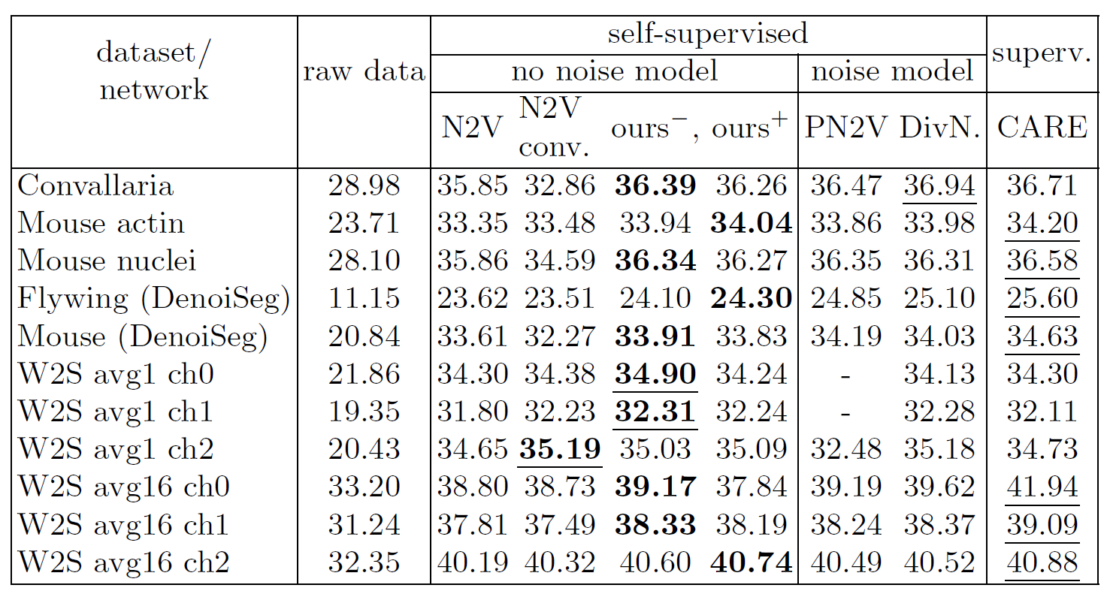
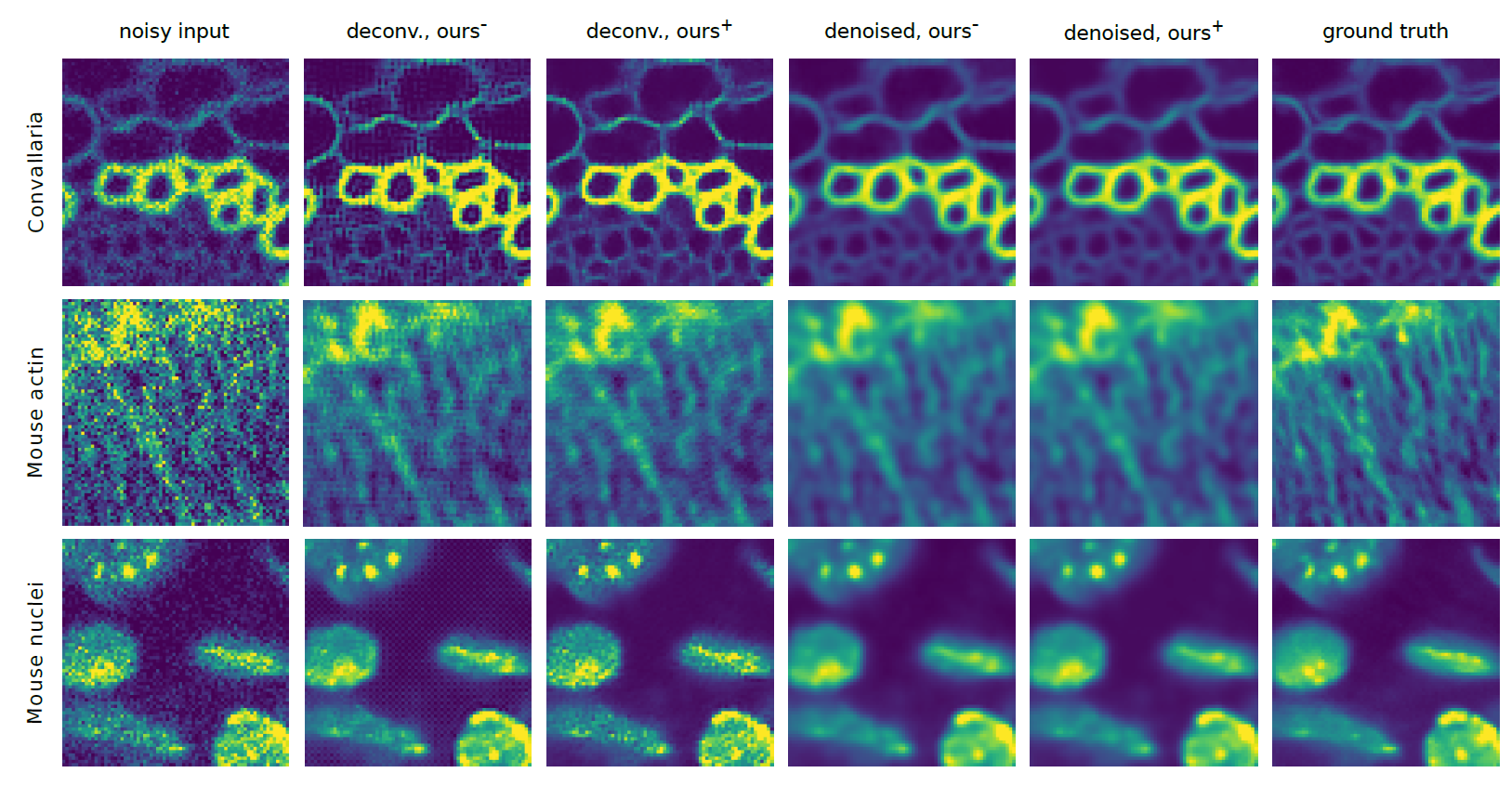

Slide 21
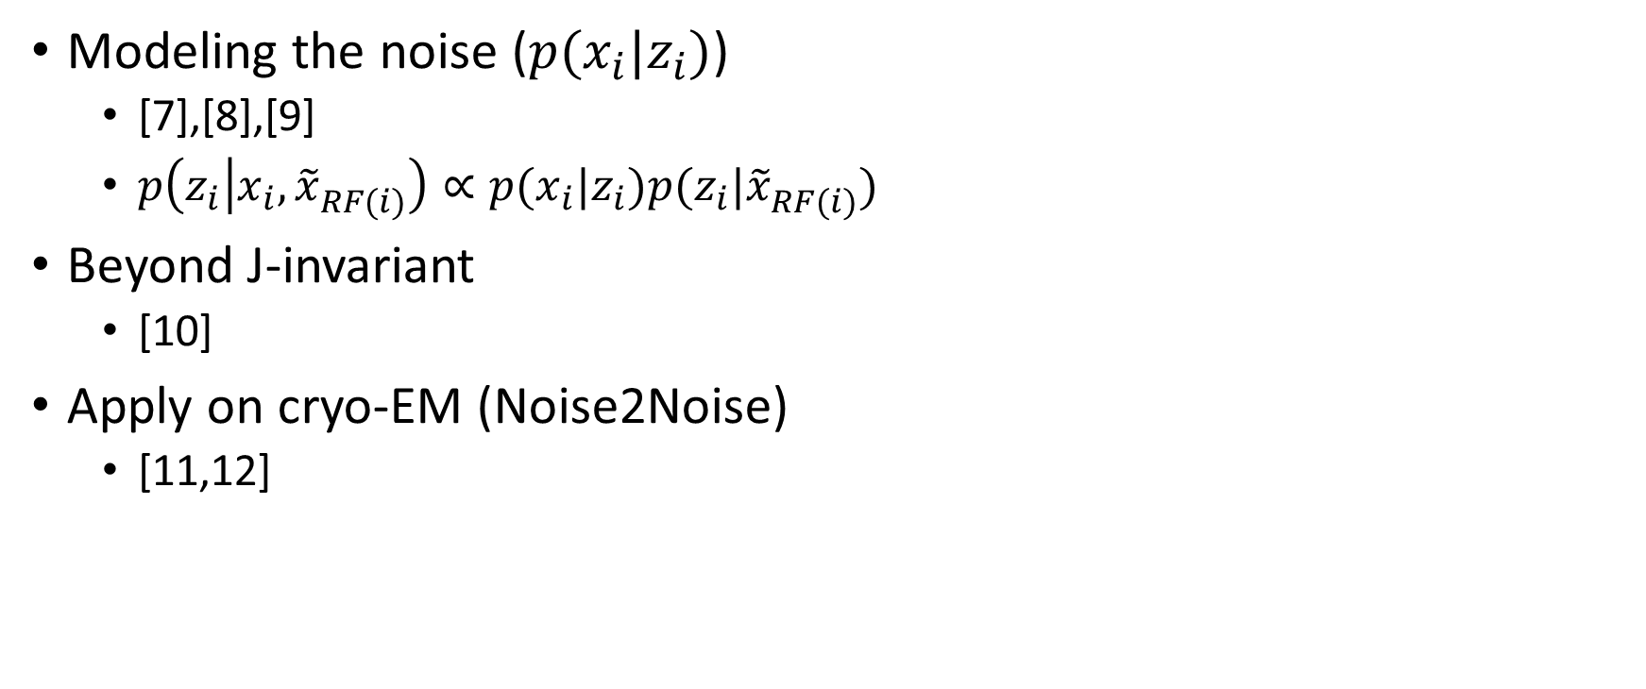
Extension
Modeling the noise ($p(x_{i}|z_{i})$)
[7],[8],[9]
$p\left(z_{i} | x_{i},{\tilde{x}}_{RF(i)}^{}\right)∝p(x_{i}|z_{i})p(z_{i}|{\tilde{x}}_{RF(i)}^{})$
Beyond J-invariant
[10]
Apply on cryo-EM (Noise2Noise)
[11,12]

Slide 22
References
[1] Batson, Joshua, and Loic Royer. "Noise2Self: Blind Denoising by Self-Supervision." International Conference on Machine Learning. 2019.
[2] Krull, Alexander, Tim-Oliver Buchholz, and Florian Jug. "Noise2void-learning denoising from single noisy images." Proceedings of the IEEE Conference on Computer Vision and Pattern Recognition. 2019.
[3] Lehtinen, Jaakko, et al. "Noise2Noise: Learning Image Restoration without Clean Data." International Conference on Machine Learning. 2018.
[4] Broaddus, Coleman, et al. "Removing Structured Noise with Self-Supervised Blind-Spot Networks." 2020 IEEE 17th International Symposium on Biomedical Imaging (ISBI). IEEE, 2020.
[5] Kobayashi, Hirofumi, et al. "Image Deconvolution via Noise-Tolerant Self-Supervised Inversion." arXiv preprint arXiv:2006.06156 (2020).
[6] Goncharova, A. S., Honigmann, A., Jug, F., & Krull, A. (2020). Improving Blind Spot Denoising for Microscopy. arXiv preprint arXiv:2008.08414.

Slide 23
References
[7] Krull, Alexander, Tomas Vicar, and Florian Jug. "Probabilistic noise2void: Unsupervised content-aware denoising." arXiv preprint arXiv:1906.00651 (2019).
[8] Prakash, M., Lalit, M., Tomancak, P., Krul, A., & Jug, F. (2020, April). Fully unsupervised probabilistic noise2void. In 2020 IEEE 17th International Symposium on Biomedical Imaging (ISBI) (pp. 154-158). IEEE.
[9] Laine, S., Karras, T., Lehtinen, J., & Aila, T. (2019). High-quality self-supervised deep image denoising. In Advances in Neural Information Processing Systems (pp. 6970-6980).
[10] Xie, Yaochen, Zhengyang Wang, and Shuiwang Ji. "Noise2Same: Optimizing A Self-Supervised Bound for Image Denoising." Advances in Neural Information Processing Systems 33 (2020).
[11] Bepler, T., Kelley, K., Noble, A. J., & Berger, B. (2020). Topaz-Denoise: general deep denoising models for cryoEM and cryoET. Nature communications, 11(1), 1-12.
[12] Palovcak, E., Asarnow, D., Campbell, M. G., Yu, Z., & Cheng, Y. (2020). Enhancing SNR and generating contrast for cryo-EM images with convolutional neural networks. bioRxiv.

